Slide 2
Unit 4: Discrete System (7 hrs)
4.1 Introduction To Discrete System
4.2 Components Of The Discrete System
4.3 Representation Of Time
4.4 Examples For Discrete System
4.4.1 Telephone Call System As Lost Call And Delayed Call System
4.4.2 Bank Queue System
4.5 Simulation Programming Task
4.6 Steps Of Simulation Programming Task
4.7 Gathering Statistics
4.7.1 Counters And Summary Measures
4.7.2 Measuring Utilization And Occupancy
4.7.3 Recording Distribution And Transit Time
4.8 Discrete System Simulation Languages

Slide 3
Simulation of Telephone System
The simulation of a discrete system can be explained by simulating a telephone system as below:
The system has several telephones (here only 8 are shown), connected to a switchboard by line.
The switchboard has several lines, provided the condition that only one connection at a time can be made to each line.
Any call that cannot be connected at the time it arrives is immediately abandoned, and then the system is called a lost call system.

Slide 4
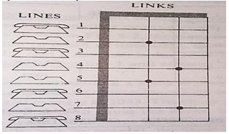
Simulation of Telephone System
A call may be lost due to the following reasons:
If the called party is engaged (busy)
If no link is available (a blocked call)

Slide 5
Object of Simulation
To process a given number of calls and determine what portion is successfully completed, blocked, or found to be busy calls.
Lost Call System
Delayed Call System
Let us consider the current state of the system as below:

Slide 6
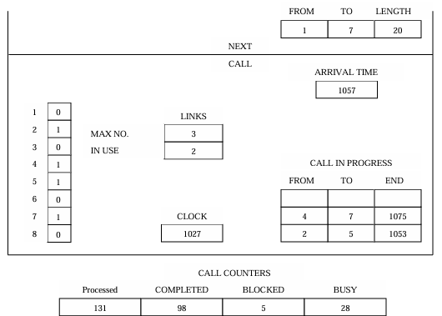
Lost Call System

Slide 7
Lost Call System
Here, line 2 is connected to line 5, and line 4 is connected to line 7.
A 0 in the line tables means it is free, and a 1 means it is busy.
The Maximum number of links, in this case, is only 3, and 2 of them are in use.
A number representing clock time is included to keep track of events. In this state, the clock time is shown to be 1027.

Slide 8
Lost Call System
The clock will be updated to the next occurrence of an event as the simulation proceeds.
Each column has its own attributes; its origin, destination, length, and the time at which it call finishes.
The “call in progress” tables show the lines that are currently connected and the finish time.
Arrival time and details of the next call are also shown to generate the arrival of calls; here bootstrap method can be used

Slide 9
Lost Call System
Two possible attributes can make change to occur in the system state:
A new call can arrive, or an existing call can be finished.
From the above figure, it can be seen that three events can occur in the figure:
Call between 2 & 5 will finish at 1053
A new call will arrive at 1057
Call between 4 & 7 will finish at 1075

Slide 10
Lost Call System
The simulation proceeds by executing a cycle below state to simulate each event:
Scans the events to determine which the next potential event is. Here, it is at 1053. The clock is updated then.
Select the activity that is to cause the event. Here, the activity is to disconnect a call between lines 2 & 5.
Test whether the potential event can be executed. Here, however, there are no conditions to disconnect a call.

Slide 11
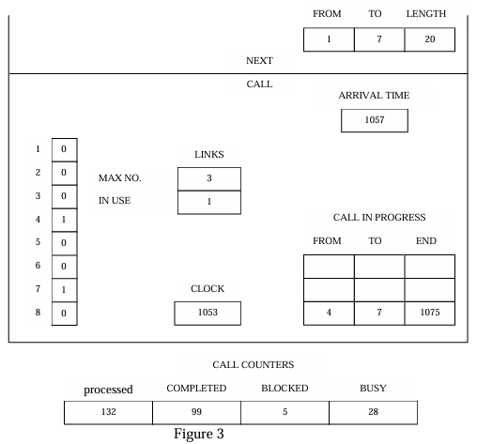
Lost Call System

Slide 12
Lost Call System
In the figure, it can be seen that the next potential event is the arrival of a call at time 1057 sec. the clock is updated to 1057, and the attributes of the new arrival are generated.
Since the selected activity is to connect a call, it is necessary to test to find whether a link is available and to find whether the party is busy or not.
In this case, the called party, line 7, is busy, so the call is lost. Both the processed call and the busy call counter are increased by one.
A new arrival is generated. These are shown in the next Figure.

Slide 13
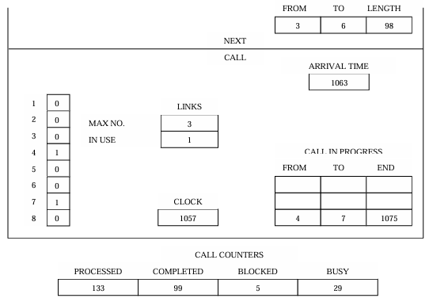
Lost Call System

Slide 14
Lost Call System
Suppose the next arrival time is 1063, and the call will be from line 3 to 6 and will spend 98 seconds, and at this time, the arriving call can be connected.
The new state of the system is shown in the next Figure.
The procedure is repeated to a certain limit until a good statistic can be gathered.

Slide 15
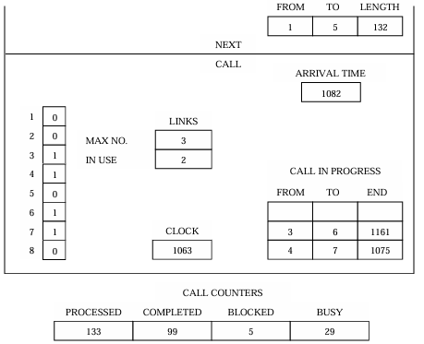
Lost Call System

Slide 16
Delayed Call System
When the telephone system is modified so that calls that cannot be connected are not lost, and then they will wait until they can be connected later.
Such calls are referred to as delayed call.
We know that it is not possible in case of a real time telephone system but possible to message in a switching system that has store and forward capability.

Slide 17
Delayed Call System
To keep a record of delayed calls, it is necessary to build another list like the call-in-progress list.
After arriving a call, if it cannot be connected, then it is placed in the delayed call list, waiting for the next time.
When a previous call is completed, it is necessary to check the delayed call list to find if a waiting call can be connected.

Slide 18
Delayed Call System
From the figure above, it is clear that the next potential event is the arrival of the next call from line 1 to 7.
Since line 7 is not free, the next call cannot be executed.
It is then placed in the delay call list waiting for the next time, and the new state of the system is shown in figure below.

Slide 19
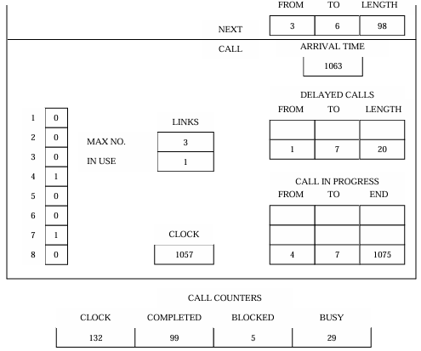
Delayed Call System

Slide 20
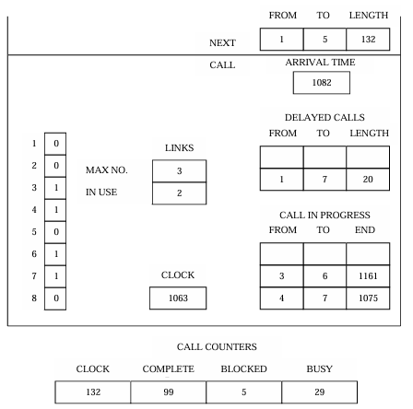
Delayed Call System

Slide 21
Delayed Call System
When the call from line 4 and 7 completed at time 1075, then for next event, the delayed call list is checked first.
At these time, the lines 1 and 7 can be connected which is shown in below figure.

Slide 22
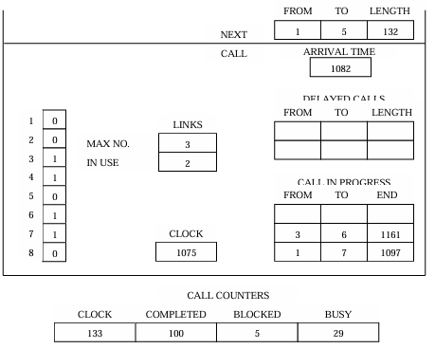
Delayed Call System

Slide 23
Assignment
Blocked Call Simulation
Bank Queue System

Slide 24
End of Lecture 12

Slide 25
Gathering Statistics Counters and Summary Statistics

